Slide 1
THE 12 VIEWS OF THE HEART
THE 12 VIEWS OF THE HEART

Slide 2
THE 12 VIEWS OF THE HEART
If the heart were as simple as a single myocardial cell, a couple of recording electrodes would give us all the information we need to describe its electrical activity.
However the heart is a three-dimensional organ, and its electrical activity must be understood in three dimensions as well.

Slide 3
THE 12 VIEWS OF THE HEART
A couple of electrodes are not adequate to do this.
The standard EKG consists of 12 leads, with each lead determined by the placement and orientation of various electrodes on the body.
Each lead views the heart at a unique angle, enhancing its sensitivity to a particular region of the heart at the expense of others.

Slide 4
THE 12 VIEWS OF THE HEART
The more views, the more information provided.
To read an EKG and extract as much information as possible, you need to understand the 12-lead system.
To prepare a patient for a 12-lead EKG, two electrodes are placed on the arms and two on the legs.
These provide the basis for the six limb leads, which include the three standard leads and the three augmented leads

Slide 5
THE 12 VIEWS OF THE HEART
Six electrodes are also placed across the chest, forming the six precordial leads.

Slide 6
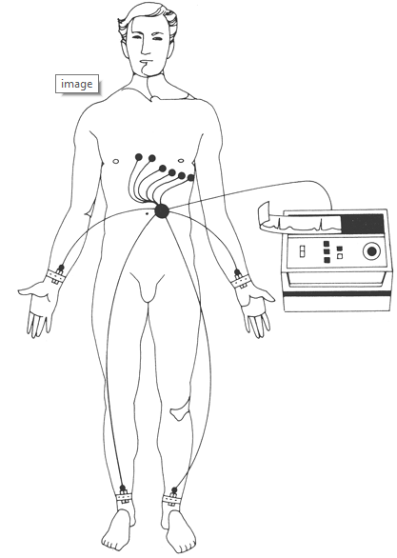
THE 12 VIEWS OF THE HEART

Slide 7
THE 12 VIEWS OF THE HEART
The precise recordings will vary somewhat depending on the precise placement of the electrodes.
Therefore, adherence to standard positioning protocols is very important to allow comparison between EKGs taken at different times in different settings.

Slide 8
THE SIX LIMB LEADS
The limb leads view the heart in a vertical plane called the frontal plane.
The frontal plane can be envisioned as a giant circle superimposed on the patient's body.
This circle is then marked off in degrees.
The limb leads view electrical forces (waves of depolarization and repolarization) moving up and down and left and right through this circle.

Slide 9
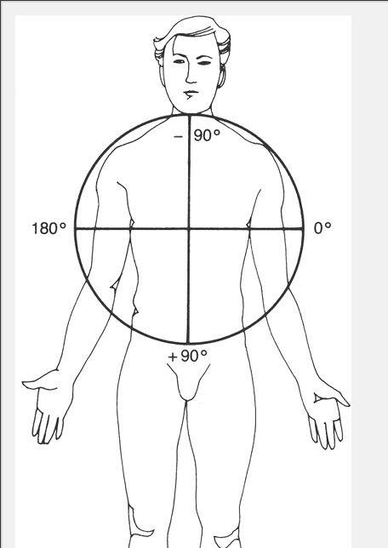
THE SIX LIMB LEADS

Slide 10
THE SIX LIMB LEADS
To produce the six leads of the frontal plane, each of the electrodes is variably designated as positive or negative (done automatically by circuitry inside the EKG machine).
Each lead has its own specific view of the heart, or angle of orientation.
The angle of each lead can be determined by drawing a line from the negative electrode to the positive electrode.

Slide 11
THE SIX LIMB LEADS
The resultant angle is then expressed in degrees by superimposing it on the 360° circle of the frontal plane.
The three standard limb leads are defined as follows:
1.Lead I is created by making the left arm positive and the right arm negative. Its angle of orientation is 0°.
2.Lead II is created by making the legs positive and the right arm negative. Its angle of orientation is 60°.

Slide 12
THE SIX LIMB LEADS
3.Lead III is created by making the legs positive and the left arm negative. Its angle of orientation is 120°.

Slide 13
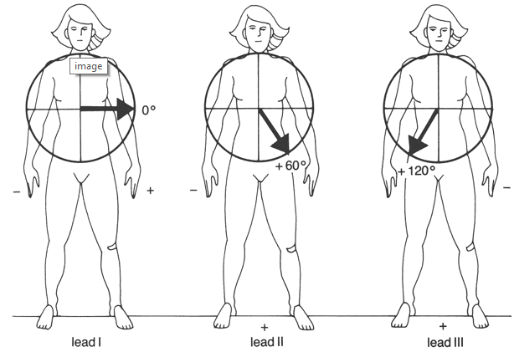
THE SIX LIMB LEADS

Slide 14
THE SIX LIMB LEADS
The three augmented limb leads are created somewhat differently.
A single lead is chosen to be positive, and all the others are made negative, with their average essentially serving as the negative electrode.

Slide 15
THE SIX LIMB LEADS
They are called augmented leads because the EKG machinery must amplify the tracings to get an adequate recording.
1.Lead AVL is created by making the left arm positive and the other limbs negative. Its angle of orientation is -30°.
2.Lead AVR is created by making the right arm positive and the other limbs negative. Its angle of orientation is -150°.

Slide 16
THE SIX LIMB LEADS
3.Lead AVF is created by making the legs positive and the other limbs negative. Its angle of orientation is +90°.

Slide 17
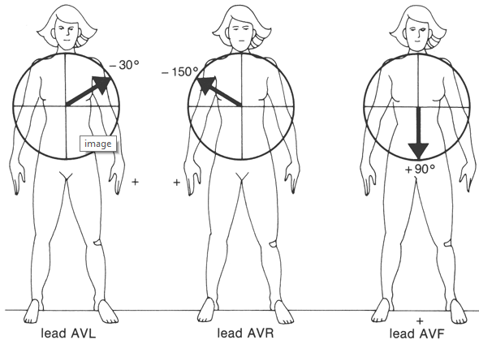
THE SIX LIMB LEADS

Slide 18
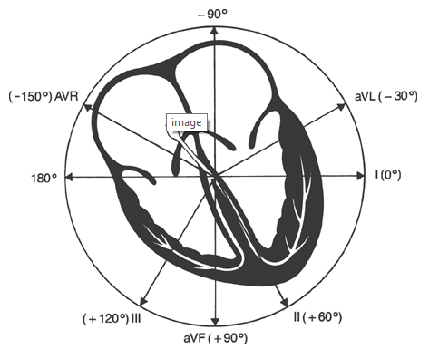
THE SIX LIMB LEADS

Slide 19
THE SIX LIMB LEADS
Leads II, III, and AVF are called the inferior leads because they most effectively view the inferior surface of the heart.
The inferior surface of the heart is an anatomic term for the bottom of the heart, the portion that rests on the diaphragm.
Leads I and AVL are often called the left lateral leads because they have the best view of the left lateral wall of the heart.

Slide 20
THE SIX LIMB LEADS
AVR is pretty much a loner, and you can call it whatever you like.

Slide 21
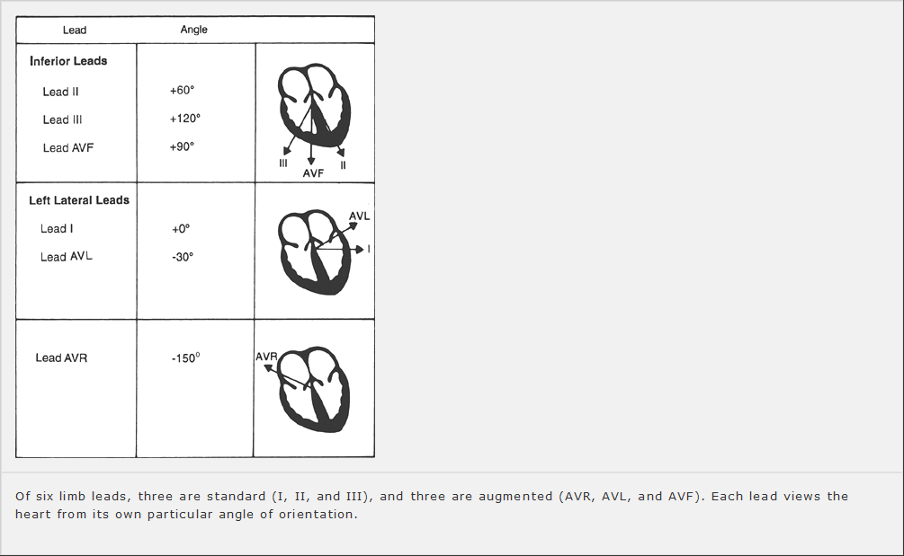
THE SIX LIMB LEADS

Slide 22
THE SIX PRECORDIAL LEADS
The six precordial leads(chest leads)are easier to understand.
They are arranged across the chest in a horizontal plane as illustrated below.
Whereas the leads of the frontal plane view electrical forces moving up and down and left and right, the precordial leads record forces moving anteriorly and posteriorly.

Slide 23
THE SIX PRECORDIAL LEADS
To create the six precordial leads, each chest electrode is made positive in turn, and the whole body is taken as the common ground.
The six positive electrodes, creating the precordial leads V₁ through V₆, are positioned as follows:
V₁ is placed in the fourth intercostal space to the right of the sternum.
V₂ is placed in the fourth intercostal space to the left of the sternum.

Slide 24
THE SIX PRECORDIAL LEADS
V₃ is placed between V₂ and V₄.
V₄ is placed in the fifth intercostal space in the midclavicular line.
V₅ is placed between V₄ and V₆.
V₆ is placed in the fifth intercostal space in the midaxillary line.

Slide 25
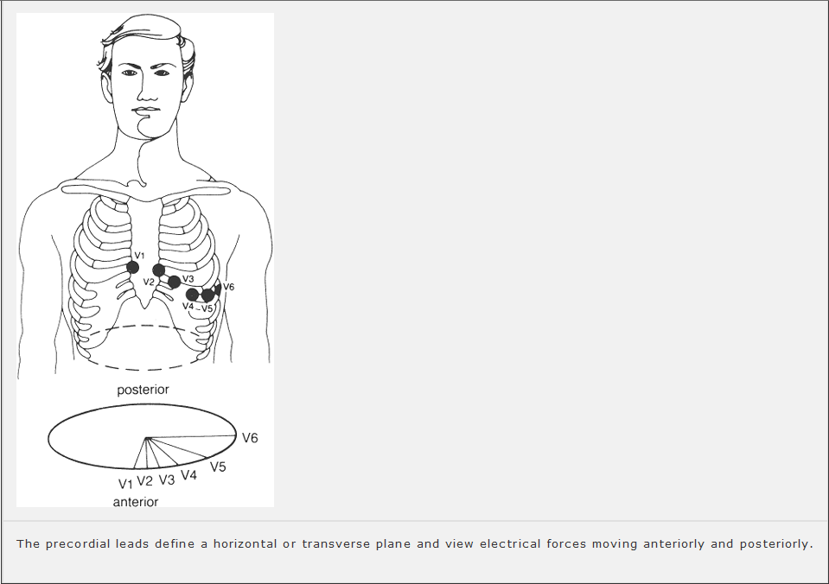
THE SIX PRECORDIAL LEADS

Slide 26
THE SIX PRECORDIAL LEADS
Just like the limb leads, each precordial lead has its own particular line of sight and region of the heart that it views best.
Note that the right ventricle lies anteriorly and medially within the body cavity, and the left ventricle lies posteriorly and laterally.

Slide 27
THE SIX PRECORDIAL LEADS
Leads V₁ and V₂ lie directly over the right ventricle, V₃ and V₄ over the interventricular septum, and V₅ and V₆ over the left ventricle.
Leads V₁ through V₄ are often referred to as the anterior leads, and V₅ and V₆ join I and AVL as left lateral leads.

Slide 28
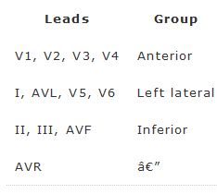
THE SIX PRECORDIAL LEADS

Slide 29
THE NORMAL 12-LEAD EKG
The three things necessary to derive the normal 12-lead EKG:
1.The normal pathway of cardiac electrical activation and the names of the segments, waves, and intervals that are generated
2.The orientation of all 12 leads, six in the frontal plane and six in the horizontal plane

Slide 30
THE NORMAL 12-LEAD EKG
3.The simple concept that each lead records the average current flow at any given moment.

Slide 31
THE P WAVE
Atrial depolarization begins at the sinus node, high up in the right atrium.
The right atrium depolarizes first, then the left atrium depolarizes.
The vector of current flow for the atria, therefore, points from right to left and slightly inferiorly (large arrow).

Slide 32
THE P WAVE
Any lead that views the wave of atrial depolarization as moving toward it will record a positive deflection on the EKG paper.
The left lateral and inferior leads clearly fit this description.

Slide 33
THE P WAVE
In the frontal plane, these leads include the left lateral leads I and AVL and the inferior leads II and AVF.
Lead III, which is also one of the inferior leads, is positioned a bit differently.
It is the most rightward (orientation +120°) of the inferior leads and actually lies nearly perpendicular to the atrial current.

Slide 34
THE P WAVE
Predictably, lead III frequently records a biphasic P wave.
Lead AVR, the most rightward of all the leads of the frontal plane (orientation -150°), sees the electrical current as moving away; hence, it records a purely negative deflection.

Slide 35
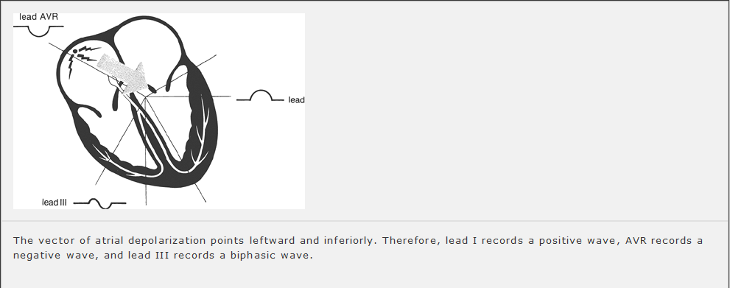
THE P WAVE

Slide 36
THE P WAVE
In the horizontal plane, the left lateral leads V₅ and V₆ record a positive deflection, just as leads I and AVL did in the frontal plane.
Lead V₁, lying over the right heart, is oriented perpendicularly to the direction of current flow and records a biphasic wave, just like lead III.
Leads V₂ through V₄ are variable.

Slide 37
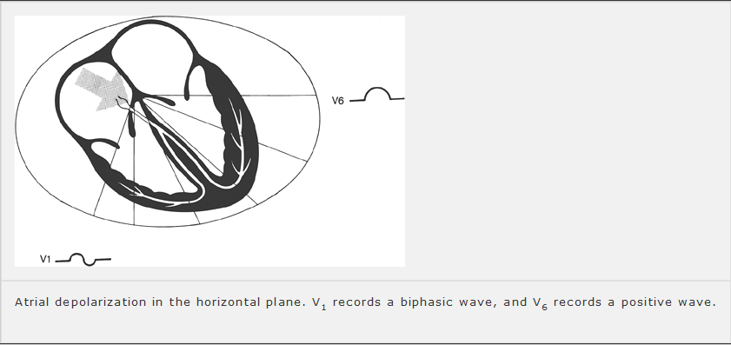
THE P WAVE

Slide 38
THE P WAVE
Because the atria are small, the voltage they can generate is also small.
The amplitude of the P wave does not normally exceed 0.25 mV (2.5 mm, or two and one half small squares) in any lead.
The P wave amplitude is usually most positive in lead II and most negative in lead AVR.

Slide 39
VARIATIONS
Variations in anatomy and orientation of the heart from person to person make absolute rules impossible.
For example, although the P wave in lead III is usually biphasic, it is not uncommon for it to be negative in perfectly normal hearts.

Slide 40
VARIATIONS
All it takes is a change of a few degrees in the vector of current flow to turn a biphasic wave into a negative one.
This can happen, for instance, if the patient's heart is angled slightly differently in the chest cavity.
For this reason, the normal angle of orientation of current vectors is given in ranges, not precise numbers.

Slide 41
THE P WAVE
For example, the normal range of the P wave vector is 0° to 70°.

Slide 42
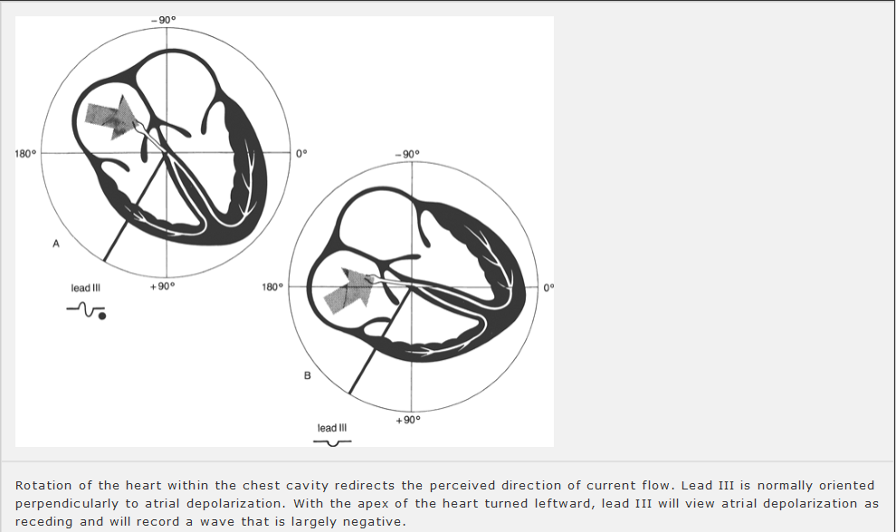
THE P WAVE

Slide 43
THE PR INTERVAL
The PR interval represents the time from the start of atrial depolarization to the start of ventricular depolarization.
It includes the delay in conduction that occurs at the AV node.
The PR interval normally lasts from 0.12 to 0.2 seconds (3 to 5 mm on the EKG paper).

Slide 44
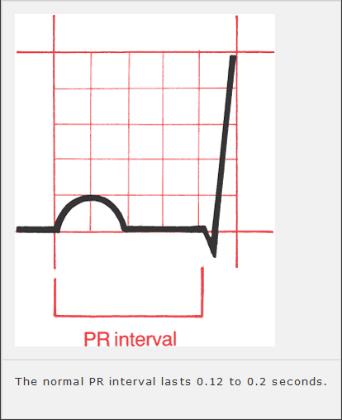
THE PR INTERVAL

Slide 45
THE PR SEGMENT
The PR segment represents the time from the end of atrial depolarization to the beginning of ventricular depolarization.
The PR segment is usually horizontal and runs along the same baseline as the start of the P wave.

Slide 46
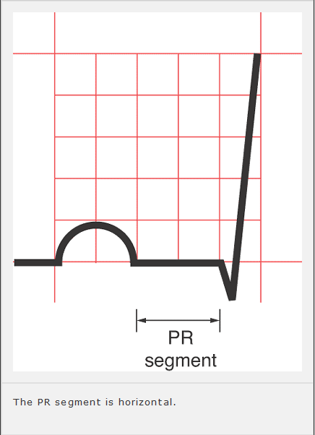
THE PR SEGMENT

Slide 47
THE QRS COMPLEX IS COMPLEX, BUT NOT COMPLICATED
Our wave of electrical depolarization, emerging from the AV node, is now ready to enter the ventricles.

Slide 48
SEPTAL Q WAVES
The interventricular septum, the wall of muscle separating the right and left ventricles, is the first to depolarize, and it does so in a left-to-right direction.
The tiny septal fascicle of the left bundle branch is responsible for rapidly delivering the wave of depolarization to this region of the heart.

Slide 49
SEPTAL Q WAVES
Septal depolarization is not always visible on the EKG, but when it is, this small left-to-right depolarization inscribes a tiny negative deflection in one or several of the left lateral leads.
This initial negative deflection, or Q wave, may therefore be seen in leads I, AVL, V₅, and V₆.
Sometimes, small Q waves may also be seen in the inferior leads and in V₃ and V₄.

Slide 50
SEPTAL Q WAVES
Normal septal Q waves have an amplitude of not greater than 0.1 mV.

Slide 51
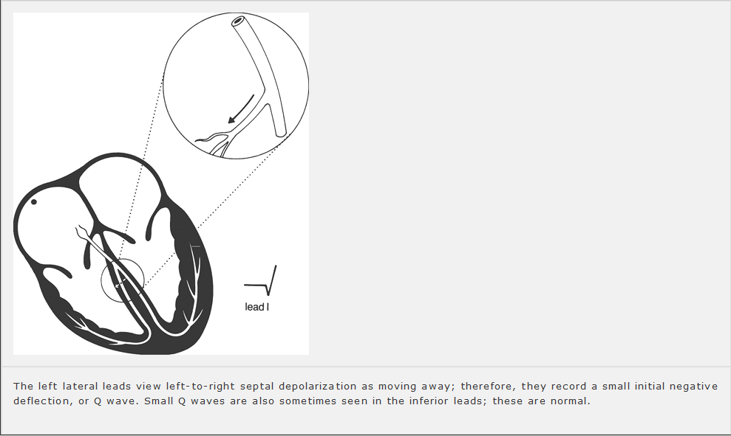
SEPTAL Q WAVES

Slide 52
THE REST OF THE VENTRICULAR MYOCARDIUM DEPOLARIZES
The remainder of the ventricles, which constitutes the vast bulk of the myocardium, depolarizes next.
Because the left ventricle is so much more massive than the right ventricle, it dominates the remainder of the QRS complex, and the average vector of current flow swings leftward.
Normally, this vector points anywhere from 0° to +90°.

Slide 53
THE REST OF THE VENTRICULAR MYOCARDIUM DEPOLARIZES
In the frontal plane, therefore, large positive deflections (R waves) may be seen in many of the left lateral and inferior leads.
Lead AVR, lying rightward, records a deep negative deflection (S wave).
In the horizontal plane, leads V₁ and V₂, which overlie the right ventricle, record deep S waves because the current is moving leftward, away from them.

Slide 54
THE REST OF THE VENTRICULAR MYOCARDIUM DEPOLARIZES
Conversely, leads V₅ and V₆, lying over the left ventricle, record tall positive R waves.
Leads V₃ and V₄ represent a transition zone, and usually one of these leads records a biphasic wave, that is, an R wave and an S wave of nearly equal amplitude.

Slide 55
THE REST OF THE VENTRICULAR MYOCARDIUM DEPOLARIZES
This pattern of progressively increasing R-wave amplitude moving right to left in the precordial leads is called R-wave progression.
Lead V₁ has the smallest R wave; lead V₅, the largest (the R wave in lead V₆ is usually a little smaller than that in lead V₅).

Slide 56
THE REST OF THE VENTRICULAR MYOCARDIUM DEPOLARIZES
We also speak of a transition zone, the precordial lead or leads in which the QRS complex goes from being predominantly negative to predominantly positive.
The normal transition zone occurs at leads V₃ and V₄.
The amplitude of the QRS complex is much greater than that of the P wave because the ventricles, having so much more muscle mass than the atria, can generate a much greater electrical potential.

Slide 57
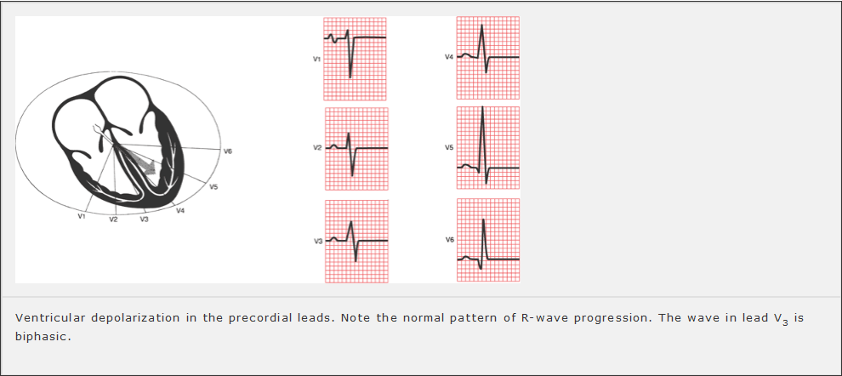
THE REST OF THE VENTRICULAR MYOCARDIUM DEPOLARIZES

Slide 58
THE QRS INTERVAL
A normal QRS interval, representing the duration of the QRS complex, is 0.06 to 0.1 seconds in duration.

Slide 59
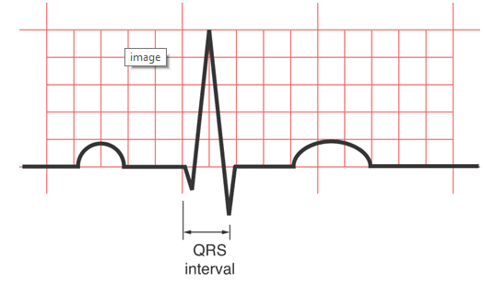
THE QRS INTERVAL

Slide 60
THE ST SEGMENT
The ST segment is usually horizontal or gently up-sloping in all leads.
It represents the time from the end of ventricular depolarization to the start of ventricular repolarization.

Slide 61
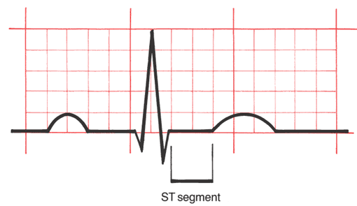
THE ST SEGMENT

Slide 62
THE T WAVE
The T wave represents ventricular repolarization.
Unlike depolarization, which is largely passive, repolarization requires the expenditure of a great deal of cellular energy (the membrane pump).
The T wave is highly susceptible to all kinds of influences, both cardiac and noncardiac (e.g., hormonal, neurologic), and is therefore variable in its appearance.

Slide 63
THE T WAVE
Nevertheless, certain general statements can be made.
In the normal heart, repolarization usually begins in the last area of the heart to have been depolarized, and then travels backward, in a direction opposite that of the wave of depolarization (large arrow).

Slide 64
THE T WAVE
Because both an approaching wave of depolarization and a receding wave of repolarization generate a positive deflection on the EKG, the same electrodes that recorded a positive deflection during depolarization (appearing as a tall R wave) will also generally record a positive deflection during repolarization (appearing as a positive T wave).

Slide 65
THE T WAVE
It is therefore typical and normal to find positive T waves in the same leads that have tall R waves.
The amplitude, or height, of a normal T wave is one third to two thirds that of the corresponding R wave.

Slide 66
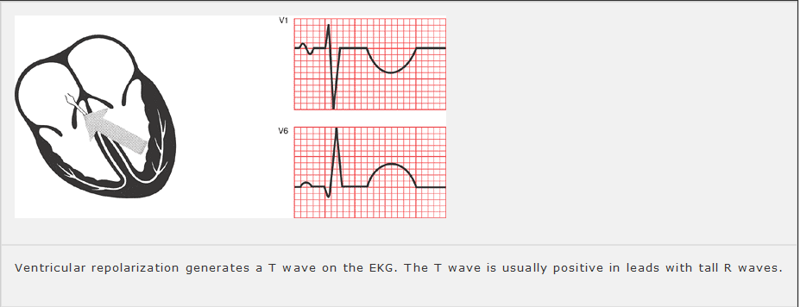

THE T WAVE

Slide 67
THE QT INTERVAL
The QT interval encompasses the time from the beginning of ventricular depolarization to the end of ventricular repolarization.
It therefore includes all of the electrical events that take place in the ventricles.

Slide 68
THE QT INTERVAL
From the standpoint of time, more of the QT interval is devoted to ventricular repolarization than depolarization (i.e., the T wave is wider than the QRS complex).
The duration of the QT interval is proportionate to the heart rate.
The faster the heart beats, the faster it must repolarize to prepare for the next contraction.

Slide 69
THE QT INTERVAL
Thus, the shorter the QT interval.
Conversely, when the heart is beating slowly, there is little urgency to repolarize, and the QT interval is long.
In general, the QT interval composes about 40% of the normal cardiac cycle, as measured from one R wave to the next.

Slide 70
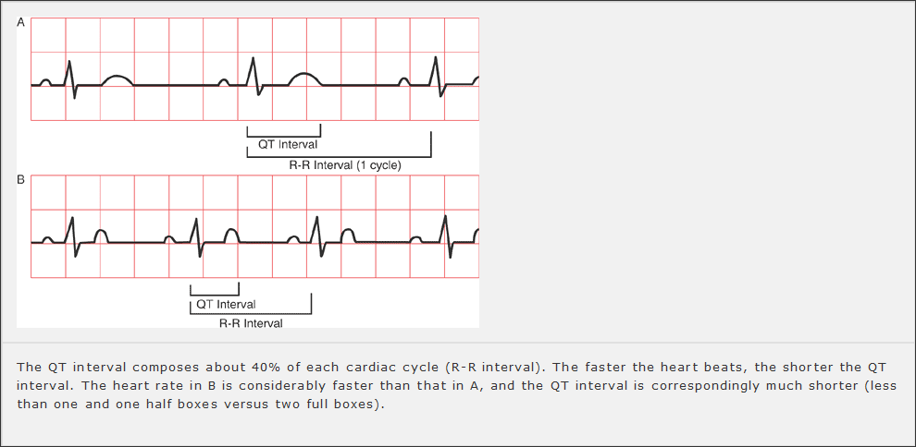
THE QT INTERVAL

Slide 71
SUMMARY
SUMMARY

Slide 72
ORIENTATION OF THE WAVES OF THE NORMAL EKG
The P wave is small and usually positive in the left lateral and inferior leads. It is often biphasic in leads III and V1. It is usually most positive in lead II and most negative in lead AVR.

Slide 73
ORIENTATION OF THE WAVES OF THE NORMAL EKG
The QRS complex is large, and tall R waves (positive deflections) are usually seen in most left lateral and inferior leads. R-wave progression refers to the sequential enlargement of R waves as one proceeds across the precordial leads from V1 to V5. A small initial Q wave, representing septal depolarization, can often be seen in one or several of the left lateral leads, and sometimes in the inferior leads.

Slide 74
ORIENTATION OF THE WAVES OF THE NORMAL EKG
The T wave is variable, but it is usually positive in leads with tall R waves.

Slide 75
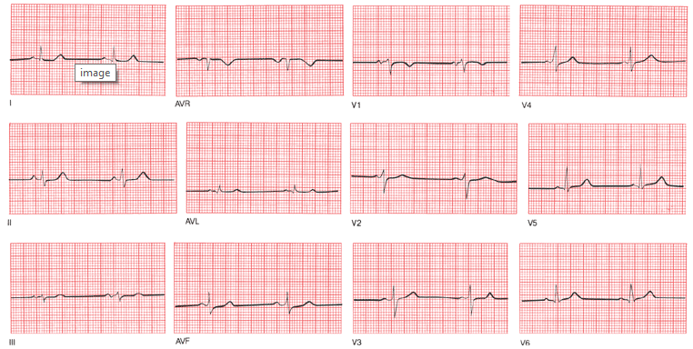
ORIENTATION OF THE WAVES OF THE NORMAL EKG

Slide 76
INDICATION
Hypertrophy and enlargement.
Abnormalities of Rhythm.
Abnormalities of Conduction.
Myocardial Ischemia and Infarction
Electrolyte Disturbances, Drug Effects, and Miscellaneous Disorders

Slide 77
THE END
THANK YOU

